Slide 1

Wine Quality Prediction
Fabiano Santos,Lewis Trenerry, Kai Huang & Sonal Bhosle

Slide 2

Introduction
This project utilizes the wine quality dataset to build and evaluate predictive models, aiming to enhance the accuracy and reliability of wine quality predictions, ultimately contributing valuable insights to the wine industry/investors/wine experts etc
Data sourced from University of California, Irvine - Machine Learning Repository
The two datasets are related to red and white variants of the Portuguese "Vinho Verde" wine.
Number of Instances: red wine - 1599; white wine - 4898.
Number of Attributes: 11 + output attribute
Notes:
Builds and evaluates predictive models aimed to enhance accuracy and reliability

Slide 3
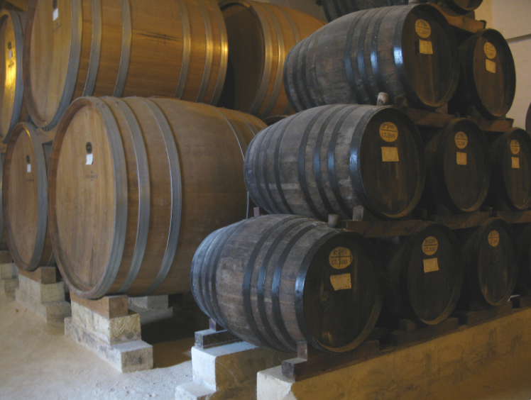
Resources
PostgreSQL
Python
VS code
Jupyter Notebook

Slide 4


Process
CSV files
SQL
ML
Analysis
Notes:
1. Red and white wine csv files from UC Irvine Machine Learning Repository website were loaded into pandas dataframe.
2.Created a new SQL Database in PostgreSQL
3.Numerous python scripts were engineered, trained and tested.
4.Analysis

Slide 5
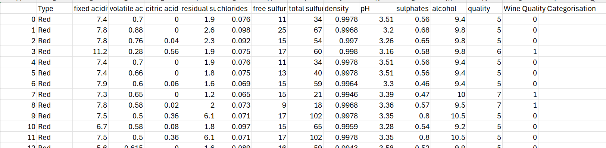
CSV
Clean the sourced data - add binary column based on quality
Import the two CSV files data to postgresSQL
Notes:
Loaded red and white wine data
Added type column to differentiate the two wine types
Added a binary 'Wine Quality Categorization' column for binary classifications
Data was then combined and saved as CVS file

Slide 6
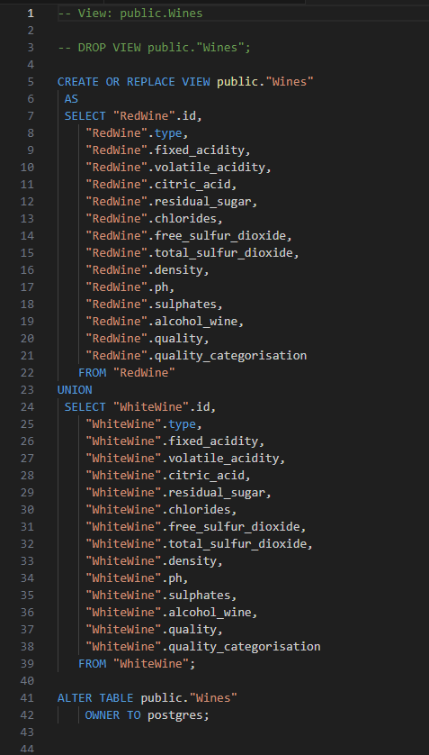
SQL
Create union in PostgreSQL
Use SQL to select data from existing PostgreSQL view
Notes:
Created a new SQL Database in PostgreSQL.
Created the tables in the new database
Created a view that combines the two tables

Slide 7
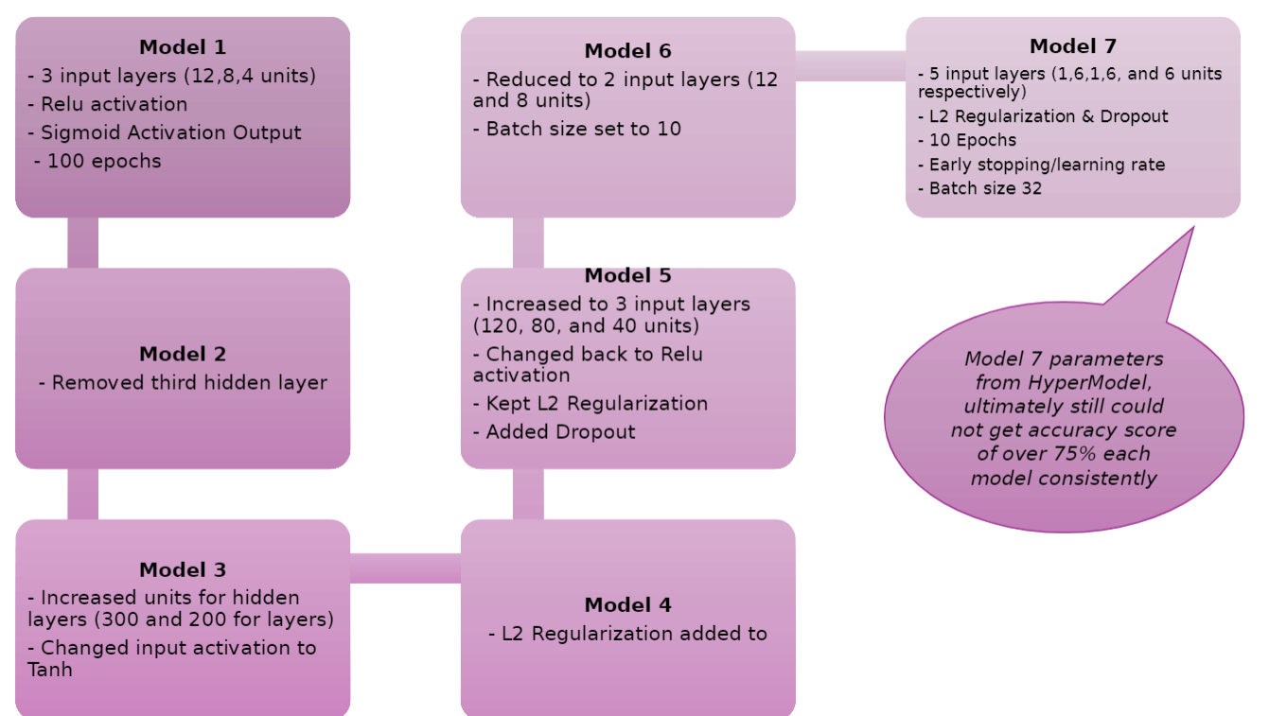
Model Optimization Attempts

Slide 8
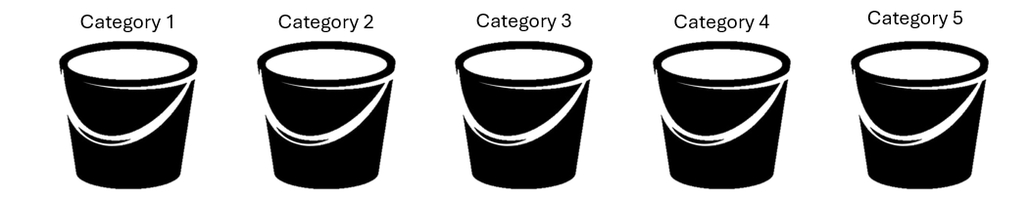

Optimum Neural Model
What we did
-Preprocessed the data using a binning method
Why we did
-Simplify complex data:
Feature 1 – 998 different values
-Reduce the effect of outliers
-Facilitate the interpretation of the data
-Reduce noise
Outcome

Slide 9

Conclusion
•Improved Accuracy:
Binning increased model accuracy above 75%.
•Key Predictive Categories:
Free sulfur dioxide, density, residual sugar.
•Business Benefits:
Enhanced marketing and pricing strategies.
•Industry Impact:
Improved product standards and brand reputation.
•Competitive Edge:
Provides a competitive advantage.

Slide 10


Slide 11

Thank You!

